Slide 1

PROGRAMMING PARADIGM
Paradigm can be termed as method to solve some problem or do some task.
The term programming paradigm refers to a style of programming.
Programming paradigms are a way to classify programming languages based on their features.
In simple words the way you represent the code in a program that is determined by the programming paradigm .For example , you can write your code in form of a real world example like objects or you can use mathematical functions to write the same code.
Fancy word huh?

Slide 2
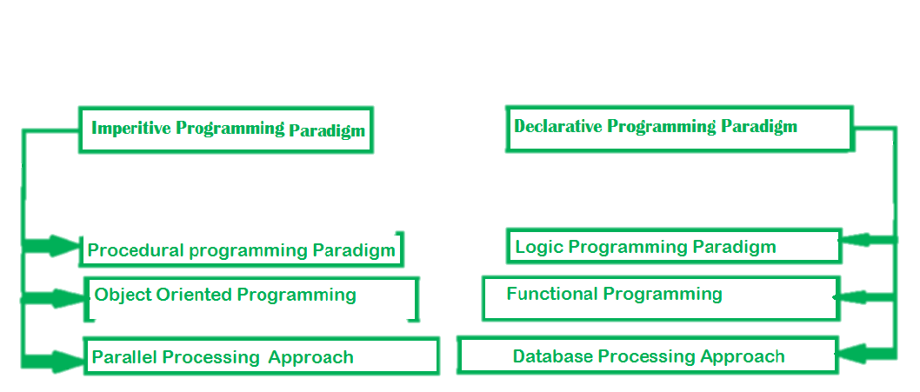
PROGRAMMING PARADIGMS
Now , we are going to learn about a beautiful paradigm known as functional programming . we will be seeing it’s important features , advantages and disadvantages .we will be comparing to a widely used programming paradigm known as OOPS . We will be also discussing why major languages like c++ and python has included these features in their language.

Slide 3

Functional programming paradigm
It’s a paradigm in which we write our program in form of functions which give a desired result by giving a certain input. All the variables used in the function used in then function is scoped within the function.
Functional programming languages are designed on the concept of mathematical functions that use conditional expressions and recursion to perform computation.
The functional programming paradigm has its roots in mathematics and it is language independent.
In the functional programming paradigm, the functions do not modify any values outside the scope of that function and the functions themselves are not affected by any values outside their scope.
Some famous purely functional languages are Haskell , Scala , Clojure etc.

Slide 4

Features of functional programming
Referential Transparency
Functions are first class citizens
Modular Programming
Immutability
Higher-order Functions
Lazy Evaluation
Primary Flow Controls
Concurrency and parallelism.
Polymorphism
Abstraction
Encapsulation
Inheritance.
Supports Nested Functions
Use of lambda expression
Wasn’t expecting!!

Slide 5
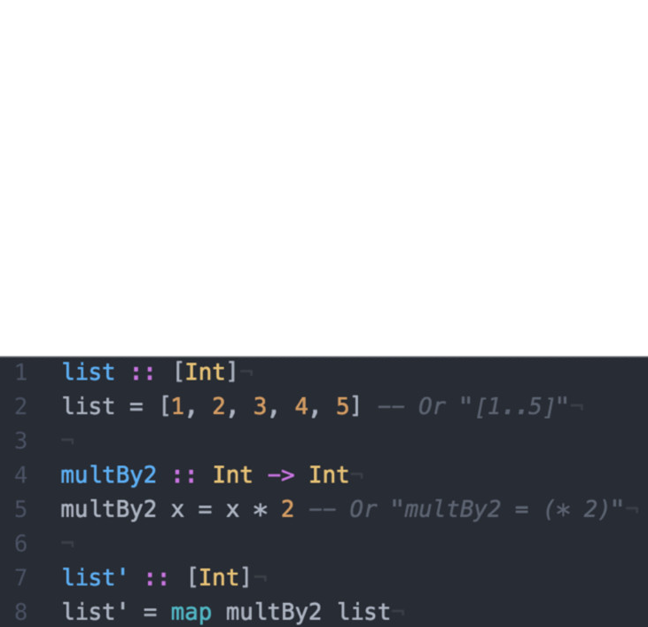
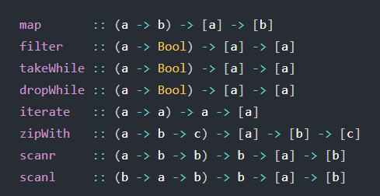
Why Functional programming paradigm is special?
Functions are first class citizens
Functions in the functional programming style are treated as variables. This makes them first-class functions. These can be passed to other functions as parameters or returned from functions or stored in data structures.
Here , list is directly passed as parameter in function using map which is a higher order function.
Higher-order Functions
A function that can take other functions as arguments or return functions is called a higher-order function. These are particularly useful in that they allow us to create new functions on top of the ones we already have, by passing functions as arguments to other functions. Hence the name, higher-order functions.
Above Higher Order functions are predefined in Haskell here a , b , c are datatypes .

Slide 6
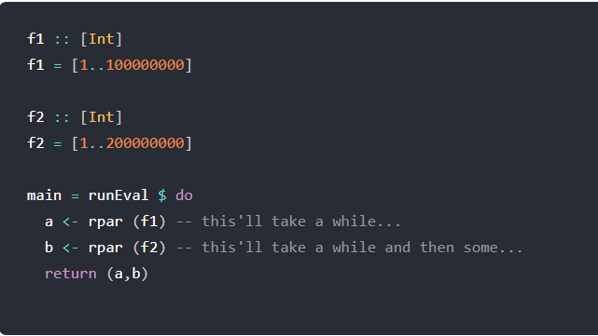
Concurrency and parallelism
Parallelism is about speed exploiting parallel processors to solve problems quicker.
Concurrency is about nondeterminism managing the unpredictable external world.
In the functional paradigm, due to immutability as a default construct, concurrent programming guarantees deterministic execution, even in the case of a shared state.
It also ensures parallel processing.
Running main above will execute and "return" immediately, while the two values, a and b are computed in the background through rpar.
rpar :: Strategy a (runs strategy in parallel).
Referential Transparency
Referential transparency is an oft-touted property of (pure) functional languages, which makes it easier to reason about the behavior of programs.
In a referentially transparent program, a function/method invocation can be freely replaced with its return value without changing the program's semantics

Slide 7
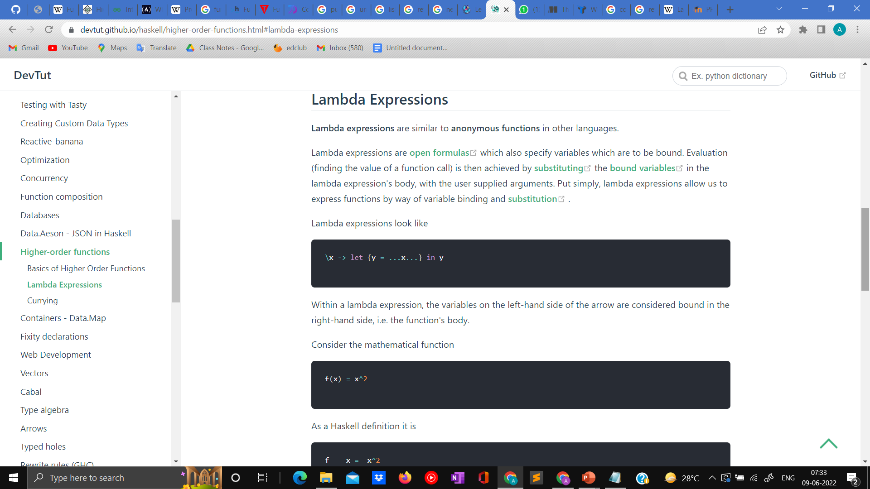
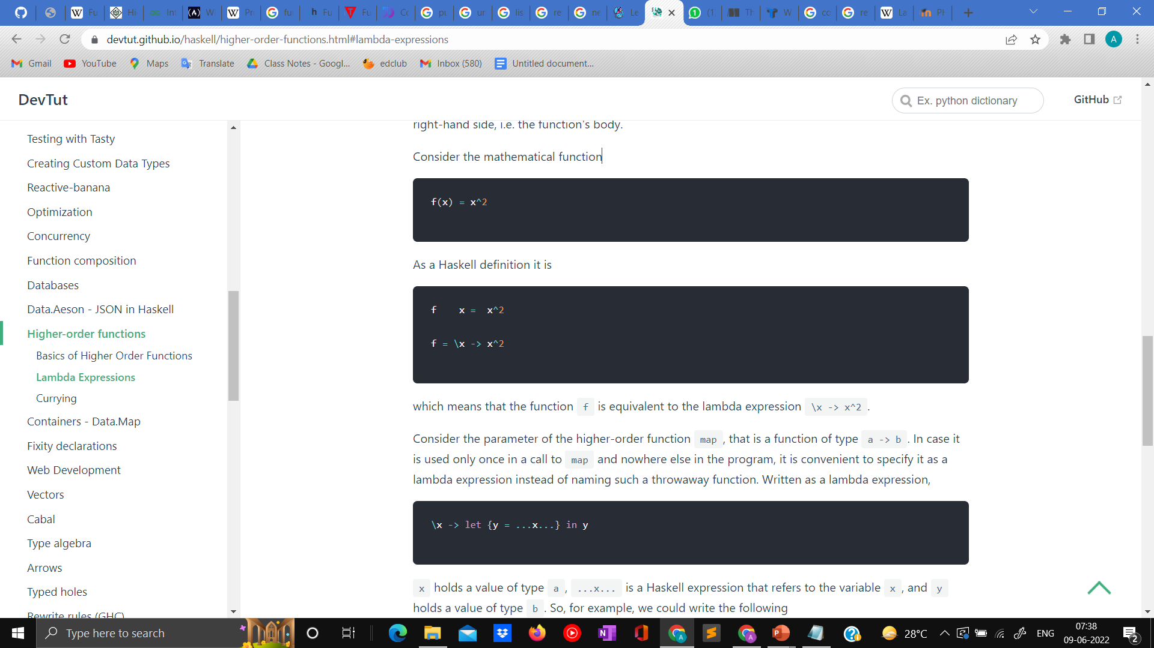
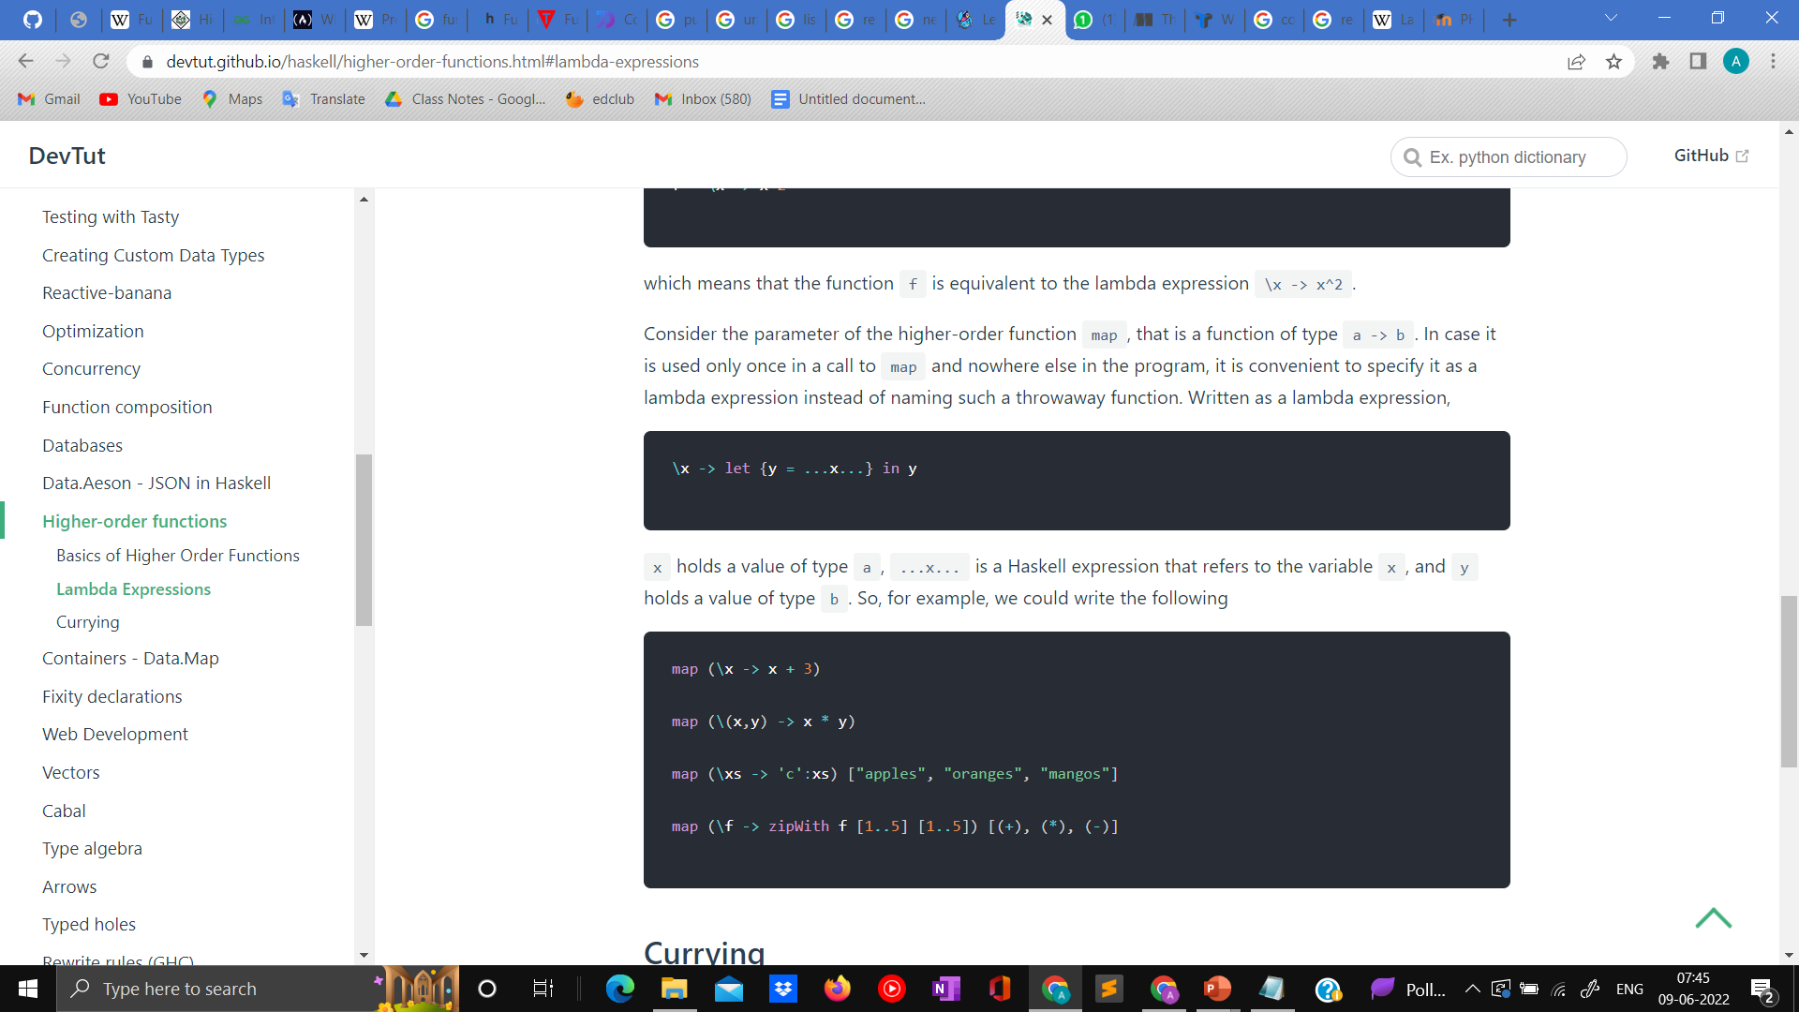
Use of lambda expression
Lambda calculus (also written as λ-calculus) is a formal system in mathematical logic for expressing computation based on function abstraction and application using variable binding and substitution.
With the help of lambda calculus functions are written in functional languages that are governed by the rules of lambda calculus. It is just a way of representing expressions in functional languages.
Lambda expressions are similar to anonymous functions in other languages.
Lambda expressions are open formulas which also specify variables which are to be bound. Evaluation (finding the value of a function call) is then achieved by substituting the bound variables in the lambda expression's body, with the user supplied arguments. Put simply, lambda expressions allow us to express functions by way of variable binding and substitution .
Languages that widely use lambda functions are Haskell , python , c++ etc.
Within a lambda expression, the variables on the left-hand side of the arrow are considered bound in the right-hand side, i.e. the function's body.
which means that the function f is equivalent to the lambda expression \x -> x^2.
It’s convenient to define the function in lambda expression inside map.

Slide 8
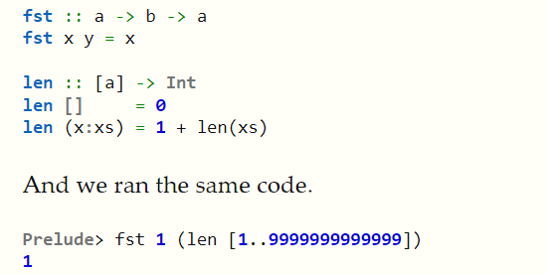
Lazy Evaluation
Used in functional programming to retrieve the result of a function on demand or to defer the analysis of a big data stream until needed.
Immutability
A property that prevents modification of an object state after creation. In FP there’s no concept of variable assignment. Once a value has been associated with an identifier (which replaces the name of variable in FP), it can’t change.
Immutability removes the problems of memory corruption.
Here , Len is not evaluated as it was not required in the program for final result.(Haskell language)
Modular Programming
Modular programming (also referred to as modular architecture) is a general programming concept. It involves separating a program’s functions into independent pieces or building blocks, each containing all the parts needed to execute a single aspect of the functionality.

Slide 9
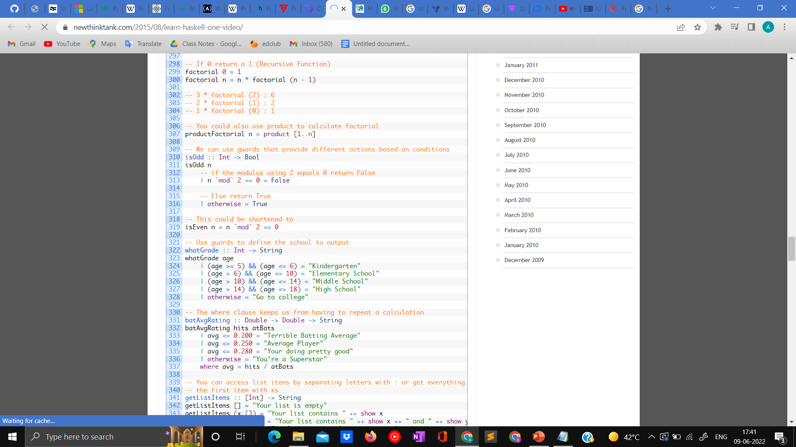
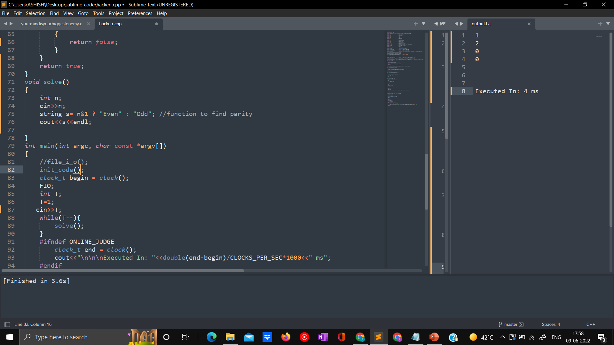
Comparative study of merits and demerits of OOP vs Functional programming
Primary Flow Controls
FP Languages don’t use Flow Controls like For…Loop, Do…While Loop, While…Loop etc , and also don’t use Conditional statements like If Else or Switch Statements. All FP Languages write programs using the following things:
Functions
Function calls
Function calls with Recursion
Achieving control flow is relatively easier in OOP because of the presence of various expressions and loops .
It comes very handy when we have to write very complex programs.
In OOP generally we have ternary operators ,
If else statement loops which make it very handy as compare to FP.
Just for finding parity , our program is very big in size.(language: Haskell)
Due to this sometimes writing code becomes difficult.
For finding parity in C++ , we have just written one line of code.

Slide 10
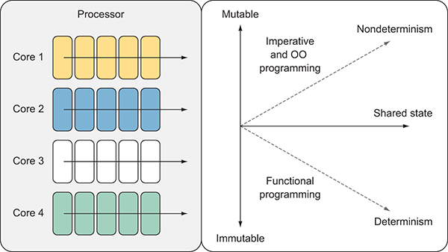
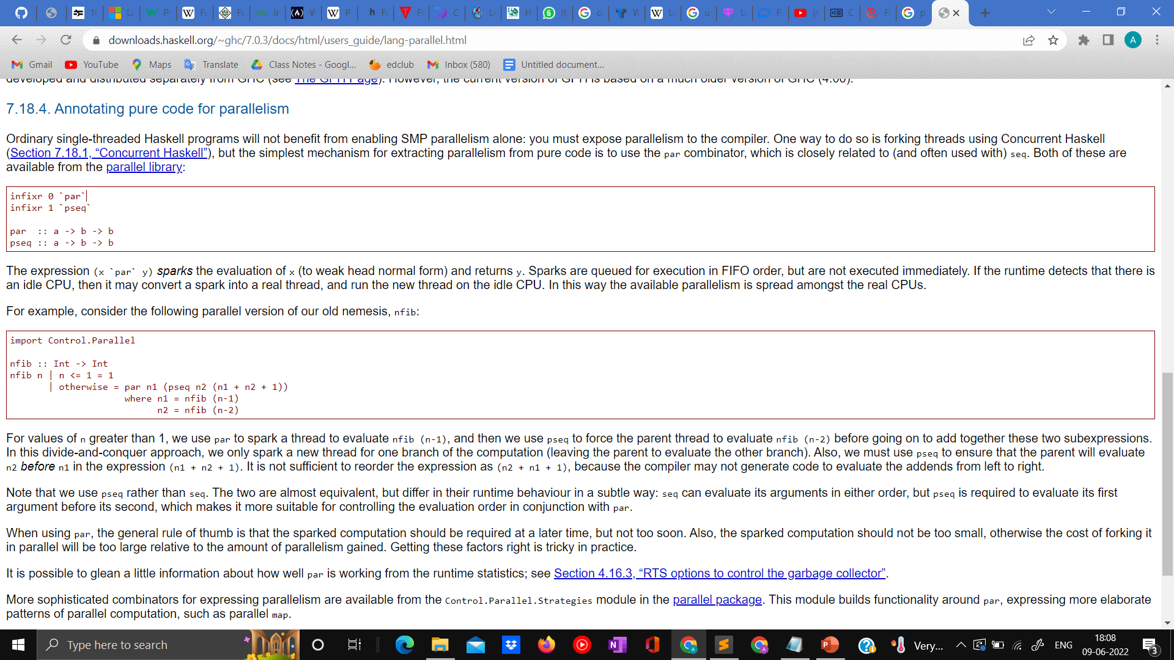
Concurrency and parallelism
FP is about minimizing and controlling side effects, commonly referred to as pure functional programming. FP uses the concept of transformation, where a function creates a copy of a value x and then modifies the copy, leaving the original value x unchanged and free to be used by other parts of the program.
FP is the most practical way to write concurrent programs. Trying to write them in imperative languages isn’t only difficult, it also leads to bugs that are difficult to discover, reproduce, and fix. One can program "Functions" to work parallel as "instructions".
In imperative and object-oriented programming (OOP) we tend to write code that behaves sequentially, with all attention and resources focused on the task currently running. We model and execute the program by performing an ordered set of statements, one after another.
Due to mutable states achieving concurrency in OOPS is very hard because concurrency is achieved when non determinism is low where as in case of mutable states, non-determinism becomes very high. Achieving parallelism becomes very difficult because of same reason.
par to spark a thread to evaluate nfib (n-1), and then we use pseq to force the parent thread to evaluate nfib (n-2). (Haskell)

Slide 11
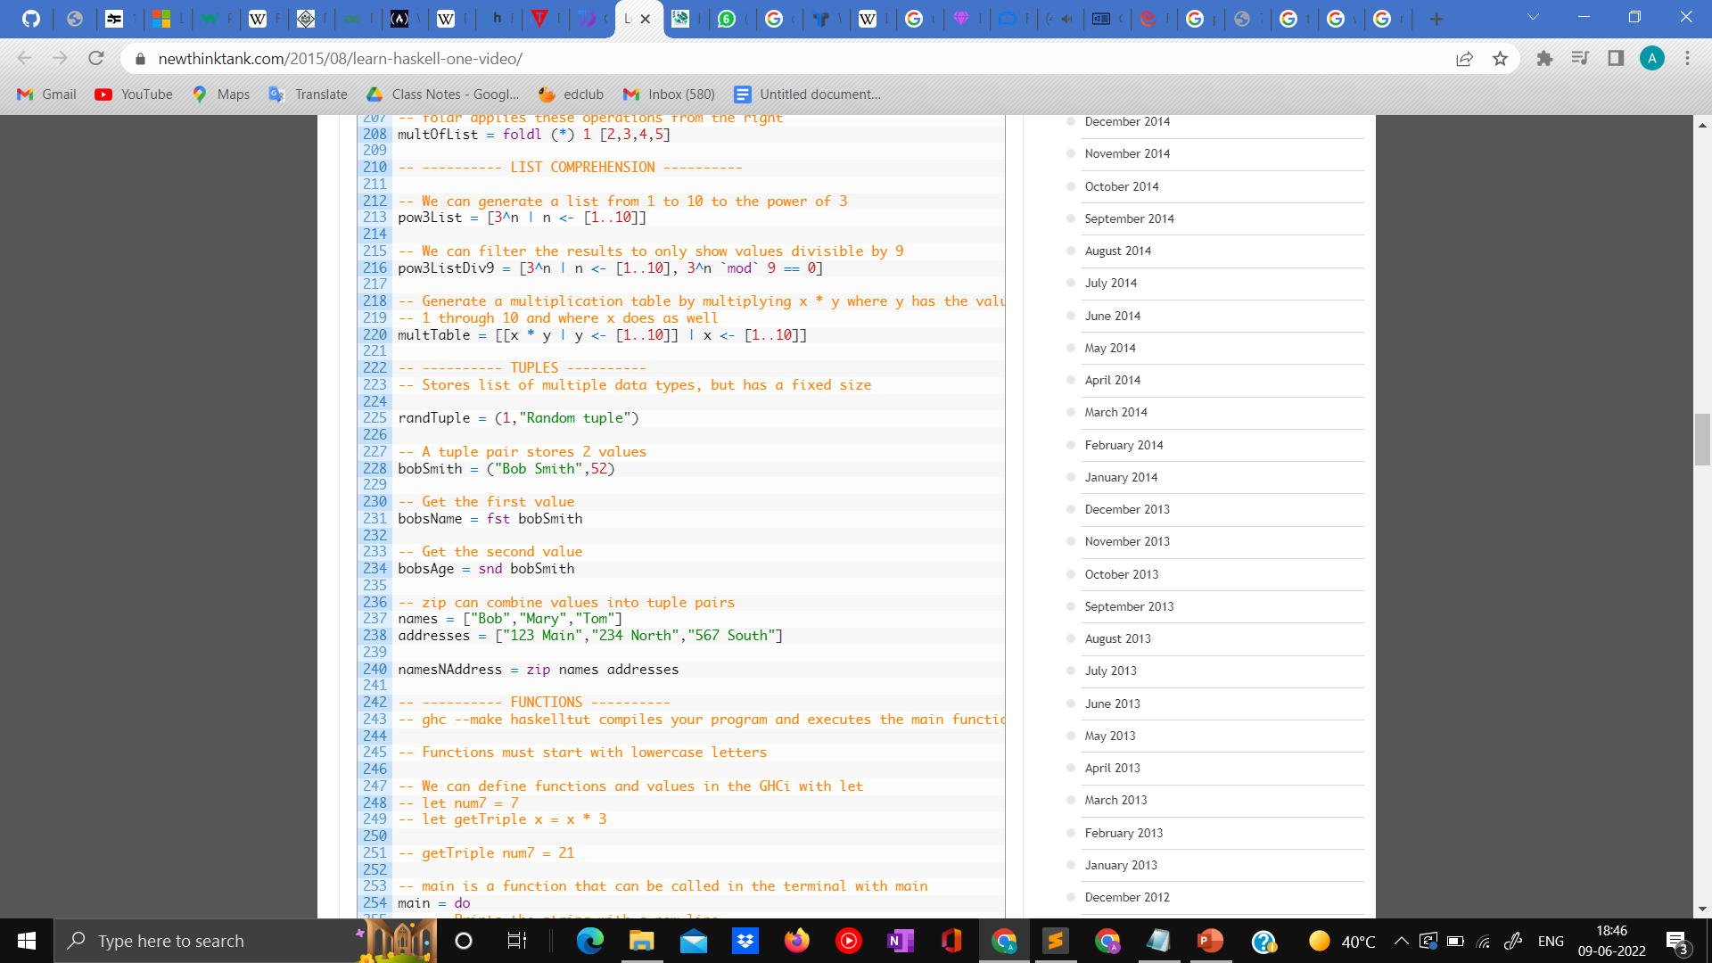

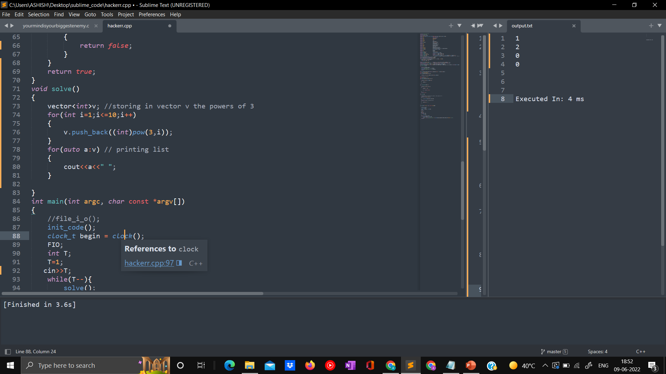
Modular Programming and easy debugging
In FP the Program is written in form of function that carry out separate task and are not influenced by the variables outside of scope.
Debugging is easier as the function is only influenced within it’s scope.
Code is almost bug free due to immutable states.
In OOP the functions are dependent on each other and a function can be influenced from outside it’s scope also.
Debugging in OOP is very tough as the states are mutable so change are seen in whole program.
Generating the powers of 3 in haskell
So little code , Awesome paradigm.
This code has both Abstraction over data and over behavior therefore it’s syntax is so small.
Fascinating isn’t it?
Abstraction over data and behavior
In FP , we have both abstraction over data as well as abstraction over behavior.
Here abstraction over Data and behavior means the inner working of function and data both is hidden from user.
In OOP , we only have abstraction over data.
Abstraction over data means only
Inner working of data is hidden.
Same code in c++ ,its much larger also it is very much dependent on other function also.
Here the inner working of the functions are not hidden therefore only abstraction over data is observed.
Despite being very fast the FP is very memory intensive , to code in pure functional language is very hard. These are some big problems of this paradigm also it doesn’t satisfy liskov substitution whereas OOP has cure for all these problems.

Slide 12
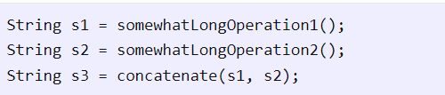
WHEN YOU SHOULD USE FUNCTIONAL PROGRAMMING OVER OOP?
Functional Programming Paradigm Should Be Used For Highly Concurrent Applications.
A functional program is ready for concurrency without any further modifications. You never have to worry about deadlocks and race conditions because you don't need to use locks! No piece of data in a functional program is modified twice by the same thread, let alone by two different threads. That means you can easily add threads without ever giving conventional problems that plague concurrency applications a second thought!
The concurrency story doesn't stop here. If your application is inherently single threaded the compiler can still optimize functional programs to run on multiple CPUs. Take a look at the following pseudo code fragment:
In a functional language the compiler could analyze the code, classify the functions that create strings s1 and s2 as potentially time consuming operations, and run them concurrently. This is impossible to do in an imperative language because each function may modify state outside of its scope and the function following it may depend on it.
a thread of execution is the smallest sequence of programmed instructions that can be managed independently by a scheduler, which is typically a part of the operating system.

Slide 13
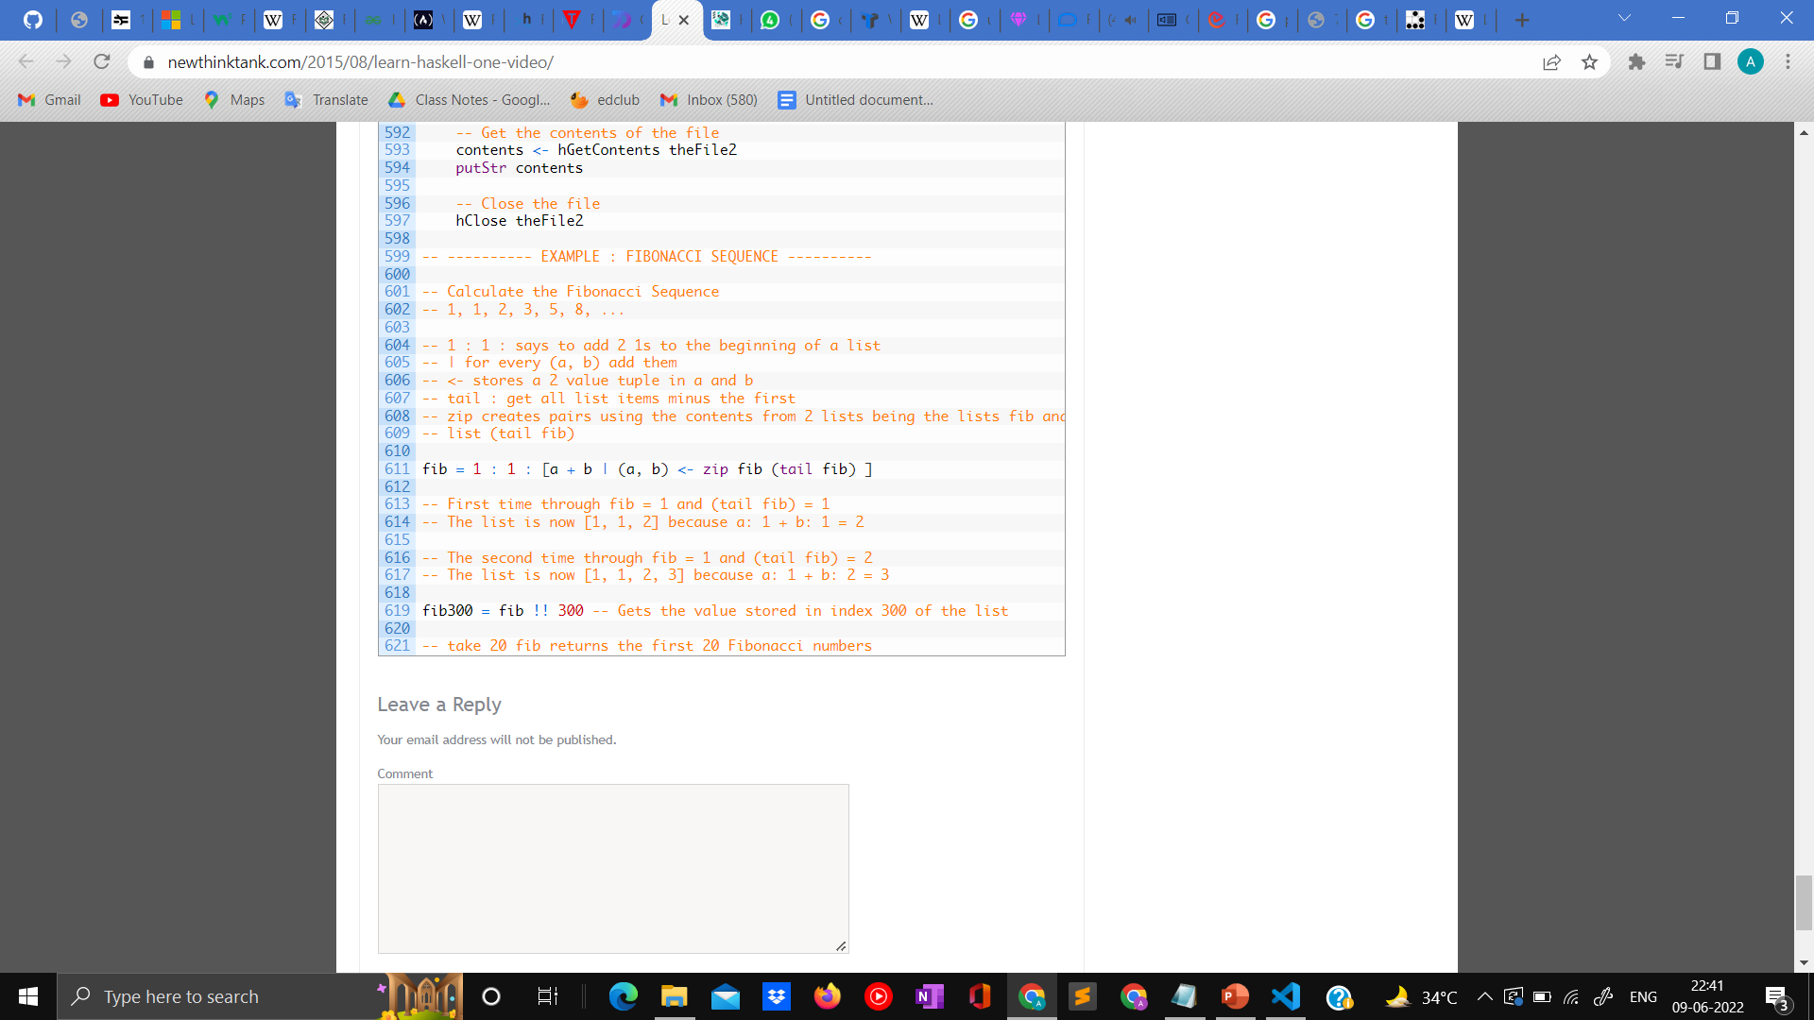
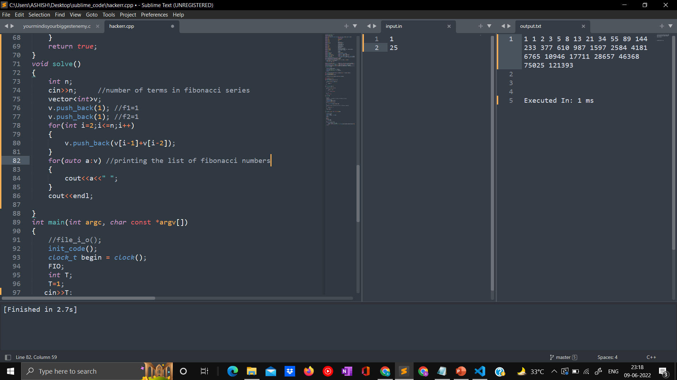
When you have to use big recursion or loops in the code. You need Strong or Heavy abstraction in your code.
Consider the case when you are making the program to find the Fibonacci series.
Fibonacci sequence in haskell. Here we have utilized the lambda expression to create a list of the Fibonacci expression. As you can easily notice the length of code only one line of code to write good amount of recursion or loop statements.
The abstraction can be seen easily here how the inner working is hidden from the user.
Fibonacci sequence in c++ ,here we have used tabular approach for calculating the Fibonacci sequence . Here we can see the abstraction in code is not very
Impressive , here you have to write the whole loop and the functions are also dependent on each other. Debugging these type of code will be hard as it is not completely functional.

Slide 14
Reasons for Introduction of functional programming Features in form of Lambda Expressions in OOP languages Like c++ , Python.
Lambda Expression is a widespread, cornerstone concept in Functional Programming that has been added to OOP/Procedural centered languages like Java , C++ ,Python to reap some of the benefits of functional programming, which is useful for things like processing data. It also provides neat, concise syntax for implementing functions on the fly. They are based of off functional programming concepts used in the construction of expression trees.
One of the main reasons for introduction of FP features in OOP languages are due to the increasing Popularity and widespread use of FP based languages in the Programming World. Many big Companies like twitter , Facebook uses functional Programming in its core.
Lambda expression are especially used in the form of features because of their simplicity and widespread uses in the FP and easy Application . These are two main reasons
for use of Lambda Expressions as the main feature in OOP languages.

Slide 15
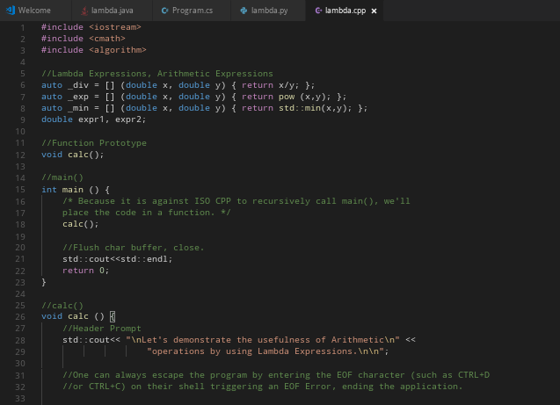
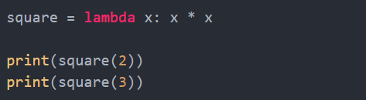
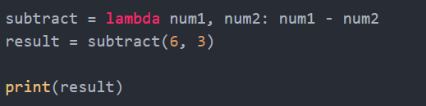
Some Lambda Expressions in C++
Some Lambda Expressions in PYTHON
It’s a basic expression which prints Hello, World!
Lambda written in front tells that the function is lambda function.
Here lambda x: tells that x is argument of the function.
results of the snippet is:4 ,9.
Here the arguments are num1 and num2 of the lambda functions,
So here the result is num1-num2.
Result is 3 .
A comparator that is used is also a type of lambda function You can see the implementation of lambda function in c++.

Slide 16
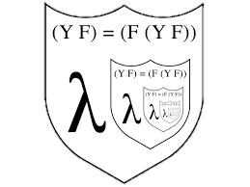
Pros of Lambda Function as features of FP in PYTHON
Lambda functions make code shorter
With lambda functions, we can avoid defining functions that are only needed at a single place, thus making our code more concise.
Useful in functional programming
lambda functions are especially helpful when working with functions like sort and map .
Supports all the different ways of passing arguments We can pass any of the following argument to a lambda functions just like a regular function:
Positional arguments Example: (lambda x, y: x + y)(1, 2)
Keyword arguments Example: (lambda x, y: x + y)(1, y=2)
Variable list of arguments Example: (lambda *args: sum(args))(1, 2)
These arguments are also valid for c++ so we can say that lambda functions are prominent functional programming feature present in OOP programming Languages.

Slide 17

USE OF FUCTIONAL PROGRAMMING IN REAL LIFE
Functional programming is compared to working “backwards” and some complain that it’s more about solving puzzles rather than working with code.
functional programming allows developers to bring the language to the problem.
Functional programming has a major role in AI, IoT, Big Data and Blockchain. These trends in early 2016-17 catalyzed the rise of functional programming among developers.
Right now there is a pressing issue with parallel processing and work related to large data streams, or in other words, Big Data. By paralleling the data processing, you can achieve results within a fraction of a second, which is critical in real world situations. Don’t forget about decentralized (distributed) computing as well – blockchains and others that are actually quite complex mechanisms.
Functional code fits such computation perfectly due to all principles of functional programming (like pure functions, for example). By using all basic principles, FP makes parallel execution of code and its support easier.
Functional programming was used only for solving some specific tasks, but now people use it even for classic projects. We can say for sure that major IT companies should not hesitate to use functional programming. Haskell a famous FP language is used by Facebook.
Functional Programming is widely used in Natural language processors ,Robotics and manufacturing ,
Integrated Circuit designing etc.

Slide 18

Advancement brought in FP Languages in past years
A language like haskell features the most longevity, but even more recent ones like Clojure are actually rooted in earlier languages that continue to shape the evolution of functional programming (FP).
As functional programming is rooted in Lambda Calculus, its history would date back to the 1930s when Alonzo Church introduced it.
In 1960 , first functional programming language was created by John McCarthy named as LISP. Salient features of LISP:
Use closures to implement static scoping To use f, it has to be bound with an environment that tells the value of x. A function with the environment for its free variables is called a closure.
Invention of the conditional expression and its use for writing recursive functions. This has something to do with the evaluation order of expressions ( lazy evaluation).
Use higher-order operations on list such as the mapcar function.
In 1978 , Researchers at University Of Edinburg defined ML(metalanguage) for LCF(logic for computable functions)
ML fit the bill for that, and they also found in 1978 that it could be useful as a general programming language.
Haskell, named after the logician Haskell B. Curry, was the product of a committee that set out to work on formulating the language in 1987 and released the first version in 1990. The latest standard is Haskell 2010, and another version has been made in 29th October 2021.

Slide 19


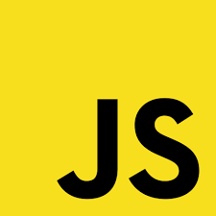


Haskell is the most dominant name for this category, likely because of its extended history relative to other FPs.
ELM is the name of a purely functional language first designed by Evan Czaplicki in 2012.
JavaScript is not strictly a functional programming language in that it also allows for an object-oriented approach, it does have component that stem from functional programming.
Among the newest of languages (released only in February 2016), Kotlin was five years in the making and the testing. Companies like Amex, NBC Digital, Expedia, and Gradle use it.
functional programming is not hard or too academic. It is just another skill to learn. It takes time and practice to master each paradigm whether it be OOP or FP .
At last I would conclude by saying that Functional Programming is the future Paradigm
Which we can conclude by seeing the popularity of many pure and impure functional Languages.
Happy Learning!!

Slide 20
SOURCES :
https://devtut.github.io/haskell/higher-order-functions.html#lambda-expressions
https://freecontent.manning.com/the-foundations-of-functional-concurrency/#:~:text=In%20the%20functional%20paradigm%2C%20due,leading%20to%20non%2Ddeterministic%20programs.
https://www.techopedia.com/definition/33988/parallel-functional-programming#:~:text=Parallel%20Functional%20Programming-,What%20Does%20Parallel%20Functional%20Programming%20Mean%3F,declarative%20programming%20in%20specific%20ways.
https://www.newthinktank.com/2015/08/learn-haskell-one-video/
https://www.journaldev.com/8693/functional-imperative-object-oriented-programming-comparison
https://wiki.haskell.org/Referential_transparency
https://wiki.c2.com/?ReferentialTransparency
https://downloads.haskell.org/~ghc/7.0.3/docs/html/users_guide/lang-parallel.html
https://www.defmacro.org/2006/06/19/fp.html
https://bulldogjob.com/readme/functional-programming-does-it-work-in-real-life
If you want to get your hands on haskell:
https://www.jdoodle.com/execute-haskell-online/

